Slide 1

SOC301B-2026
Week 5: General Linear Model
Amine Sijilmassi
amine.sijilmassi@um6p.ma

Slide 2
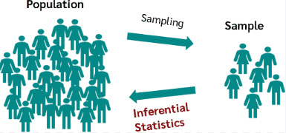
Point 1: Statistical inference

Slide 3
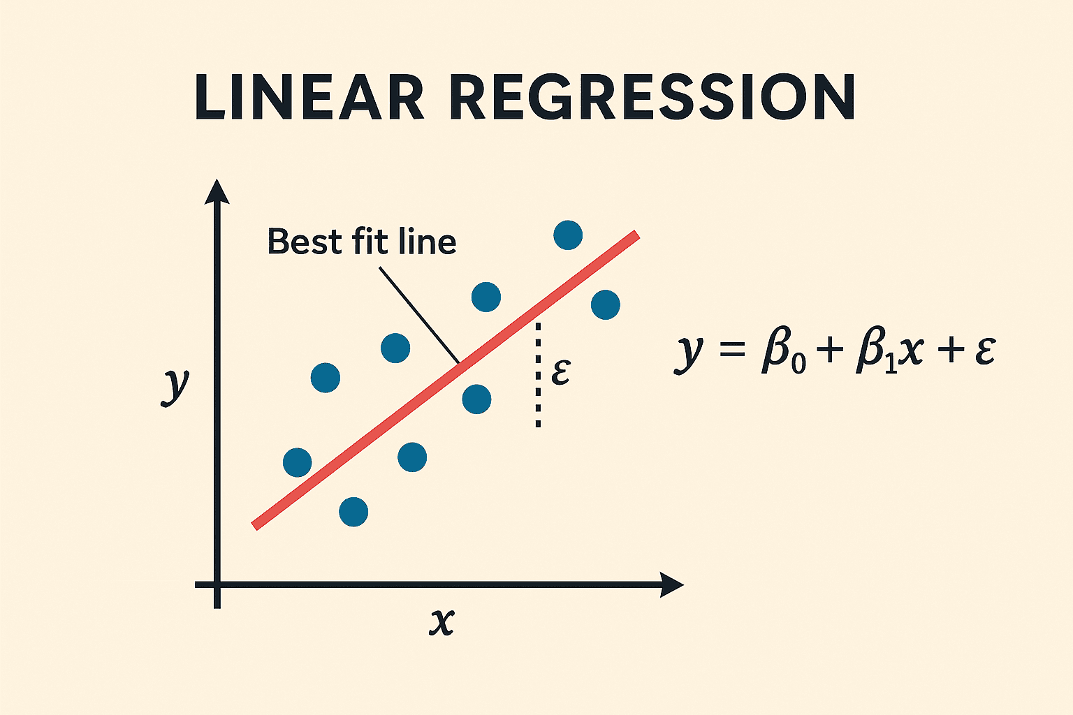
General Linear Model

Slide 4
General Linear Model
What is the effect size?
(Look at β, R²)
How likely is it that this effect also exists in the population?
(Look at p-value, confidence interval…)
Is the relationship causal?
(Look at confounds, econometric methods…)
All three are important

Slide 5
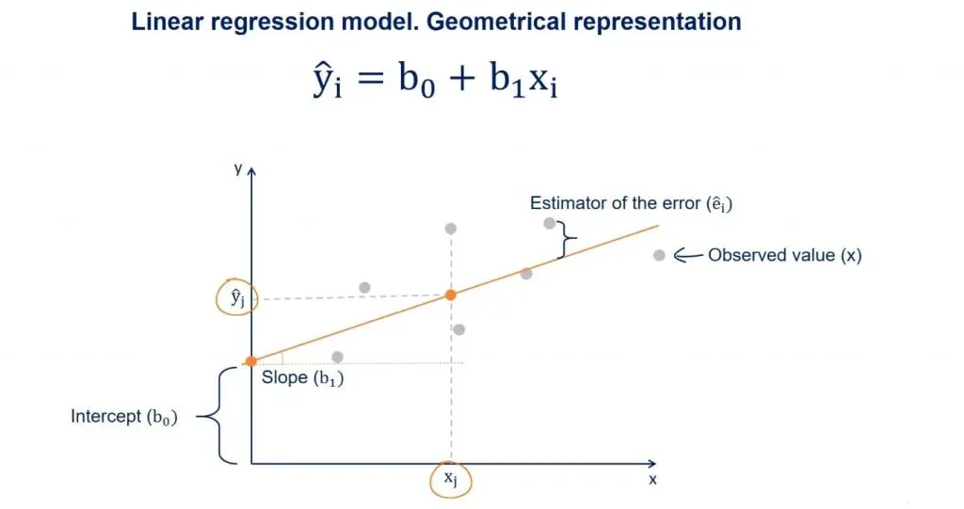

Slide 6
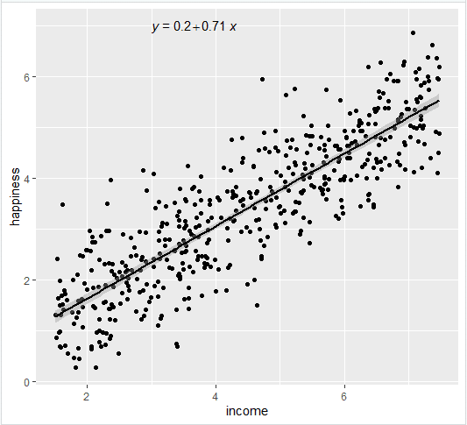

Slide 7
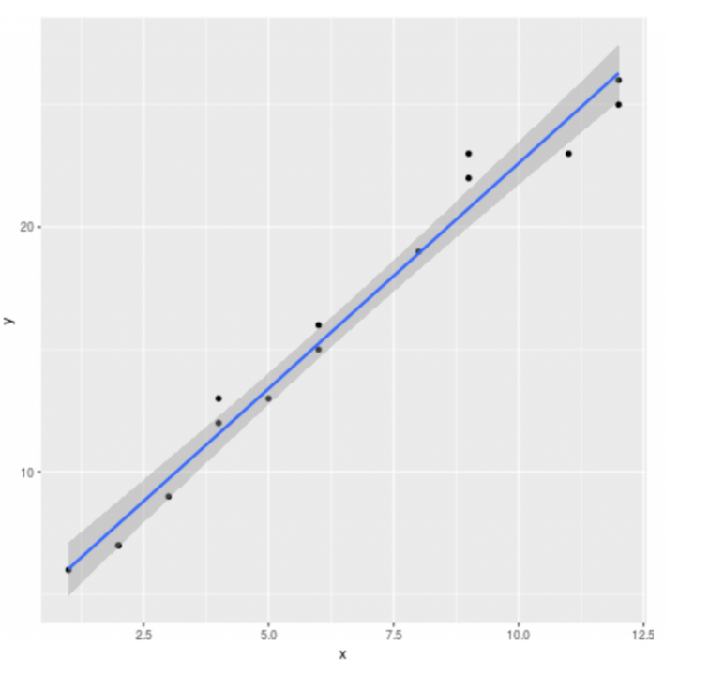
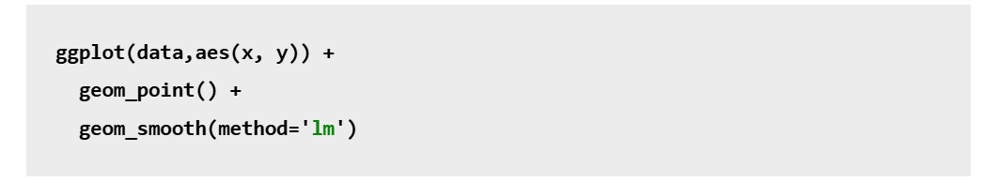
Point 2: How to plot a linear model

Slide 8
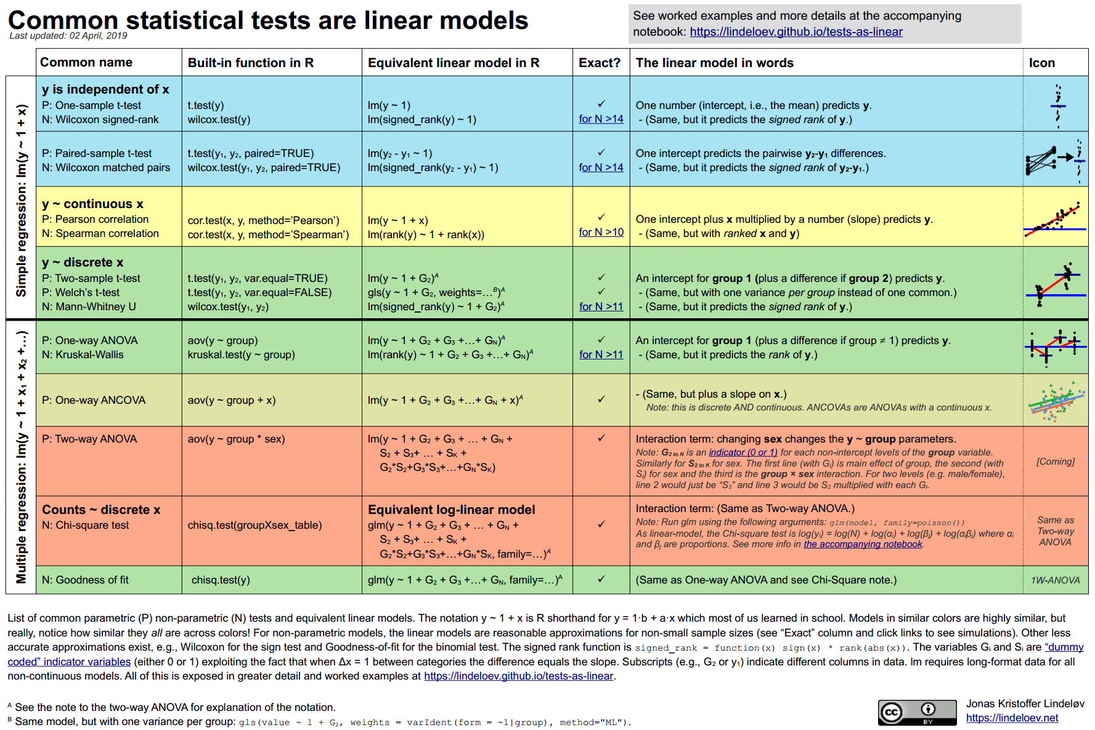
Point 3 : everything you know is a linear model

Slide 9
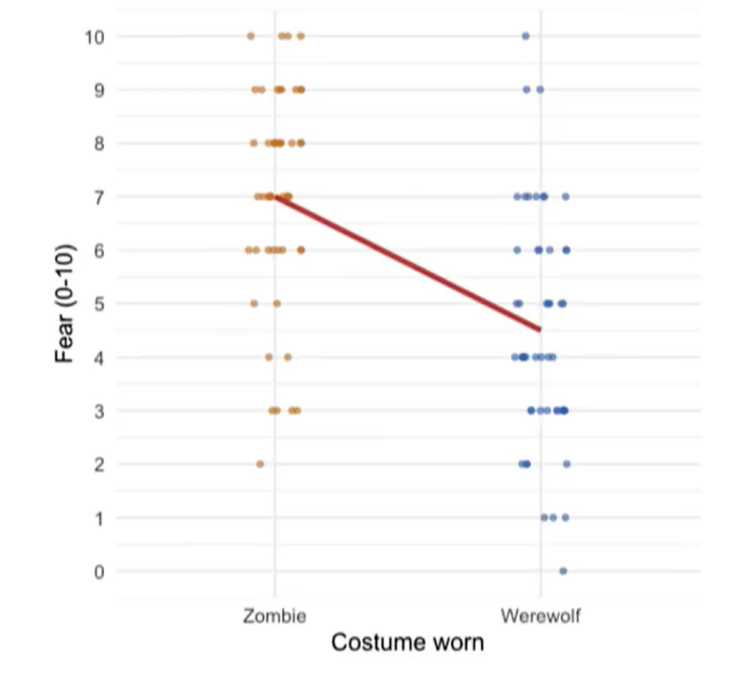
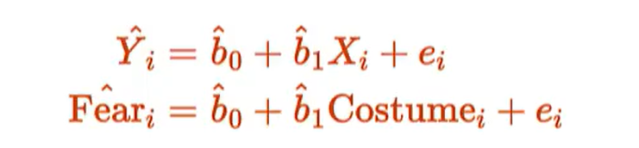
This is essentially a test between means
b0 is the "initial" mean
b1 is the effect of your condition (i.e difference in mean)
(in practice, it can be good to create a "dummy" (0/1)

Slide 10
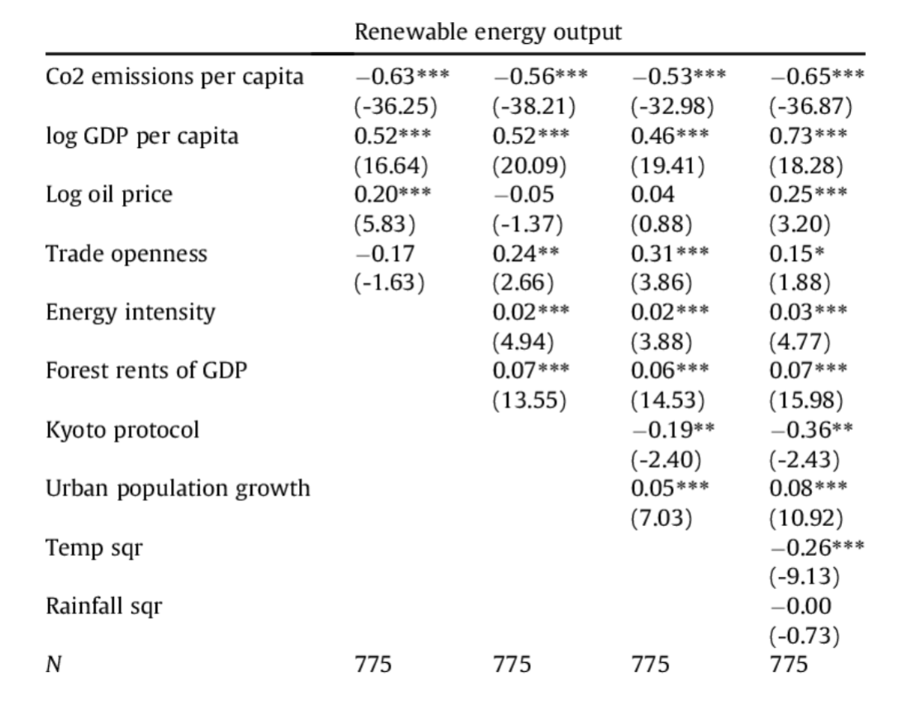

Slide 11
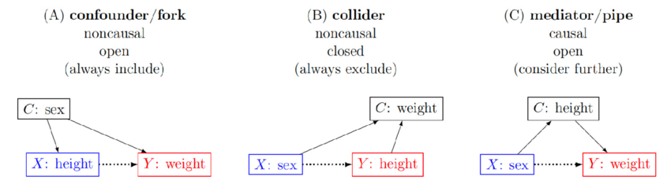
Point 4 : make DAGs

